Slide 1
Naming, Consistency & Replication

Slide 2
Learning Objectives
Define naming, naming resolution, representation and types of naming conventions in distributed systems.
Identify and define reasons for data replication and the importance of maintaining data consistency in distributed systems.
Discuss the role of redundancy in protecting systems against corrupted data.
Notes:
Students may not know exactly what is meant by globalization or may have an incomplete understanding of the term. You might ask students what they think it means. Potential answers could include: reduction of economic and cultural advantages of developed countries, increased number of companies with operations in multiple countries worldwide, and increased reliance on imports and exports of goods (and jobs). Globalization will be discussed in later slides as well.

Slide 3
Learning Objectives
Discuss the effect of performance on scalability.
Define consistency models and contractual obligations that govern their design and implementation.
Notes:
Students may not know exactly what is meant by globalization or may have an incomplete understanding of the term. You might ask students what they think it means. Potential answers could include: reduction of economic and cultural advantages of developed countries, increased number of companies with operations in multiple countries worldwide, and increased reliance on imports and exports of goods (and jobs). Globalization will be discussed in later slides as well.

Slide 4
Distributed Systems Principles
Naming
Consistency & Replication
Consistency models:
  Data-centric consistency models
  Client-centric consistency models

Slide 5
Distributed Systems Principles
Naming

Slide 6
Naming
Names are associated to entities (files, computers, Web pages etc.)
Entities;
  have a location and
  can be operated on.
Name Resolution: the process of associating a name with the entity/object it represents.
  Naming systems prescribe the rules for doing this.

Slide 7
Names
Types of names:
  Addresses
  Identifiers
  Human friendly names
Representation of names:
  Human friendly format
  Machine readable – generally random bit strings.

Slide 8
Addresses as Names
To operate on an entity in a distributed system, we need an access point.
Access points are physical entities named by an address.
  Compare to telephones, mailboxes.
Objects may have multiple access points;
  Replicated servers represent a logical entity (the service) but have many access points (the various machines hosting the service).

Slide 9
Addresses as Names
Entities may change access points over time;
  A server moves to a different host machine, with a different address, but is still the same service.
New entities may take over the vacated access point and its address.
Better: a location-independent name for an entity E ;
  should be independent of the addresses of the access points offered by E.

Slide 10
Identifiers as Names
Identifiers are names that are unique and location-independent.
Properties of identifiers:
  An identifier refers to at most one entity.
  Each entity has at most one identifier.
  An identifier always refers to the same entity; it is never reused.
An entity’s address may change, but its identifier cannot change.

Slide 11
Human-Friendly Names
Human-friendly names are designed to be used by humans instead of computers.
They usually contain contextual information; e.g. file names or DNS names.
Do not usually contain information that is useful to a computer.

Slide 12
Representation
Addresses and identifiers are usually represented as bit strings (a pure name) rather than in human readable form.
  Unstructured or flat names.
Human-friendly names are more likely to be character strings (have semantics).

Slide 13
Name Resolution
The central naming issue: how can other forms of names (human-friendly, identifiers) be resolved to addresses?
Naming systems maintain name-to-address bindings.
In a distributed system a centralized directory of name-address pairs is not practical.

Slide 14
Naming Systems
Flat Naming
  Unstructured; e.g. a random bit string.
Structured Naming
  Human-readable, consist of parts; e.g. file names or Internet host naming.
Attribute-based Naming
  An exception to the rule that named objects must be unique.
  Entities have attributes; request an object by specifying the attribute values of interest.

Slide 15
Flat Naming
Addresses and identifiers are usually pure names (bit strings – often random).
Identifiers are location-independent:
  Do not contain any information about how to locate the associated entity.
Addresses are not location-independent.
In a small LAN name resolution can be simple.
  Broadcast or multicast to all stations in the network.
  Each receiver must “listen” to network transmissions.
  Not scalable

Slide 16
Flat Names – Resolution in WANs
Simple solutions for mobile entities
  Chained forwarding pointers
    Directory locates initial position; follow chain of pointers left behind at each host as the server moves.
  Home-based approaches
    Each entity has a home base; as it moves, it updates its location with its home base.
Distributed hash tables (DHTs).

Slide 17
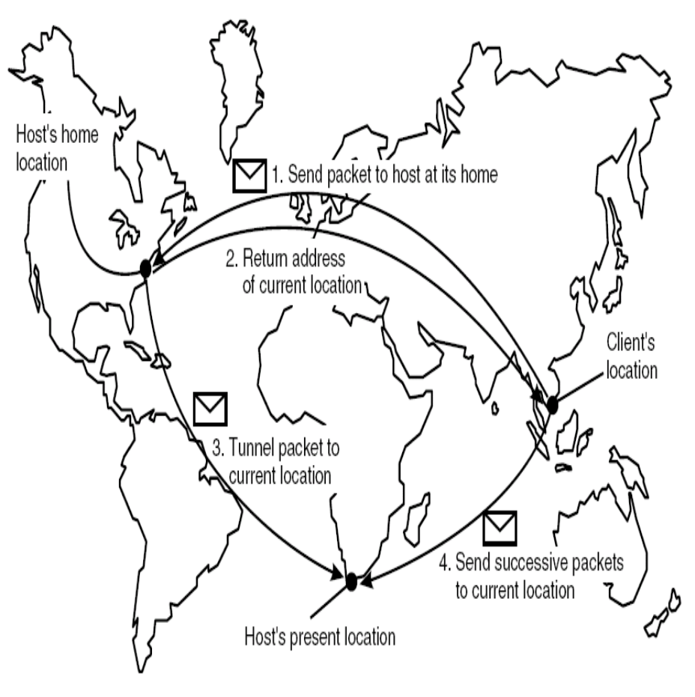
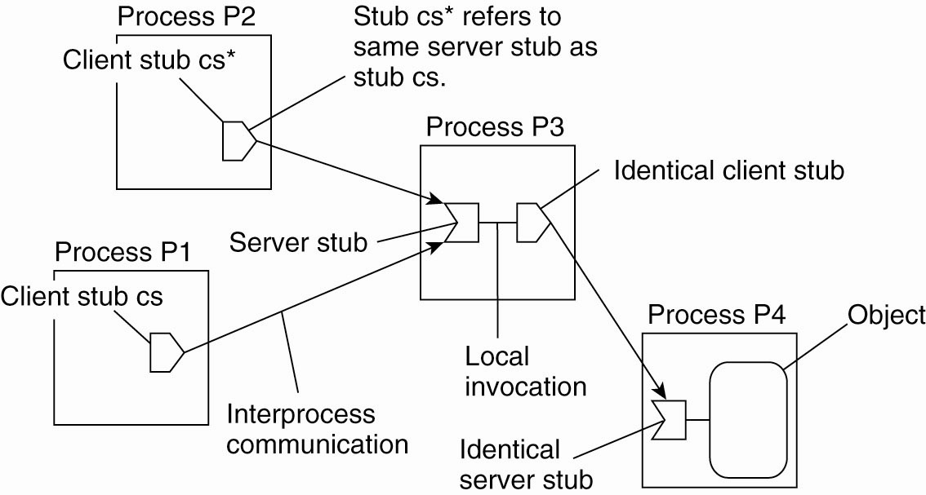
Flat Names – Resolution in WANs…
Useful for contacting mobile hosts
Figure 1-1: Resolution in WANs

Slide 18
Distributed Hash Tables/Chord
Chord is representative of other DHT approaches.
Others are CAN, Tapestry, and Pastry.
It is based on an m-bit identifier space: both host node and entities are assigned identifiers from the name space.
  Entity identifiers are also called keys.
  Entities can be anything at all e.g. a file/data item.

Slide 19
Chord
An m-bit identifier space = 2^{m} identifiers.
  m is usually 128 or 160 bits, depending on hash function used.
Each node has an m-bit id, obtained by hashing some node identifier (e.g. IP address).
Each entity has a key value, determined by the application (not Chord) which is hashed to get its m-bit identifier k.
Nodes are ordered in a virtual circle based on their identifiers.
An entity with key k is assigned to the node with the smallest identifier id such that id ≥ k. (the successor of k).

Slide 20
Simple but Inefficient Name Resolution…
Each node p ‘knows’ its immediate neighbors, its immediate successor, succ(p + 1) and its predecessor, denoted pred(p).
When given a request for key k, a node checks to see if it has the object whose id is k. If so, return the entity; if not, forward request to one of its two i.e. succ(p + 1) or pred(p) neighbours.
Requests hop through the network one node at a time.

Slide 21
Structured Naming
Flat name – bit string
Structured name – sequence of words
Name spaces for structured names – labeled, directed graphs.
Example: UNIX file system – organized hierarchically.
Example: Domain Name System (DNS)
  Distributed name resolution
  Multiple name servers.

Slide 22
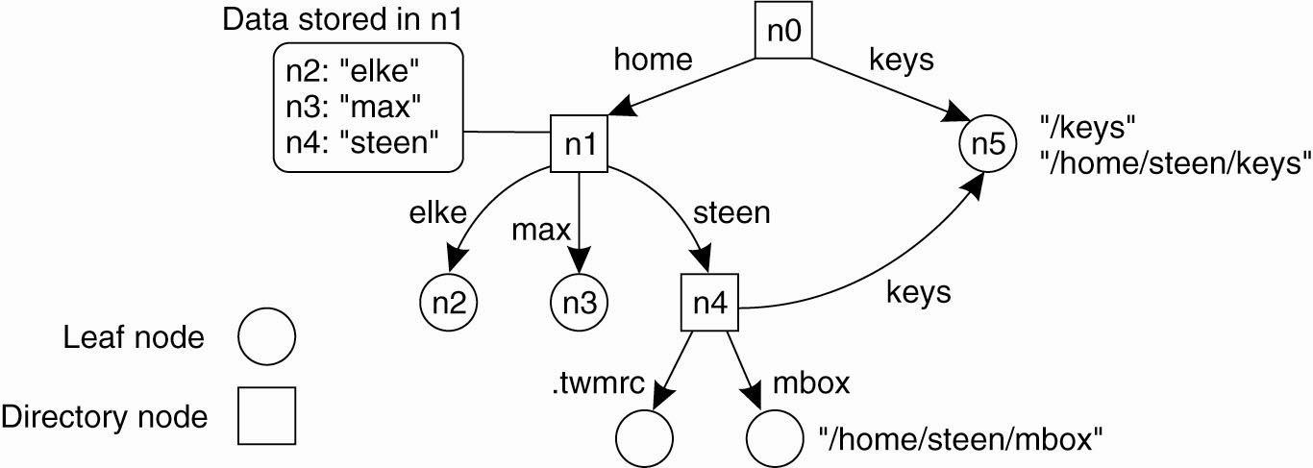
Name Spaces
Entities in a structured name space are named by a path name.
Leaf nodes represent named entities (e.g. files) and have only incoming edges.
Directory nodes have named outgoing edges and define the path used to find a leaf node.
Figure 1-2: Name Spaces

Slide 23
Attribute-Based Naming
Allows a user to search for an entity whose name is not known.
Entities are associated with various attributes, which can have specific values.
By specifying a collection of <attribute, value> pairs, a user can identify one (or more) entities.
Attribute based naming systems are also referred to as directory services, as opposed to naming systems.

Slide 24
Attribute-Based Naming…
Examples: search a music data base for a particular kind of music, or music by a particular artist or . . .
Difficulty: choosing an appropriate set of attributes – how many, what variety etc.
  E.g. should there be a category for ragamuffin music (a type of reggae)?
Satisfying a request may require an exhaustive search through the complete set of entity descriptors.

Slide 25
Attribute-Based Naming…
Not particularly scalable if it requires storing all descriptors in a single database.
RDF: Resource Description Framework
  Standardized data representation for the Semantic Web.
  Subject-predicate-object triplet (person, name, Alice).
Some proposed solutions:
  LDAP (Lightweight Directory Access Protocol) combines structured naming with attribute based names. Provides access to directory services via the Internet.

Slide 26
Attribute-Based Naming…
LDAP: directory service protocol that runs directly over the TCP/IP stack.
  based on a client-server model.
  one or more LDAP servers contain the data making up the LDAP directory tree or LDAP backend.
  an LDAP client connects to an LDAP server and asks it a question d database.
  server responds with the answer, or with a pointer to where the client can get more information (typically, another LDAP server).
  no matter what LDAP server a client connects to, it ‘sees’ the same view of the directory; a name presented to one LDAP server references the same entry it would at another LDAP server.

Slide 27
Distributed Systems Principles
Consistency and Replication

Slide 28
Why Replicate Data?
To enhance reliability and improve performance.
But: if there are many replicas of the same thing, how do we keep all of them up-to-date? How do we keep the replicas consistent?
Consistency can be achieved in a number of ways.
We will study a number of consistency models as well as protocols for implementing the models.

Slide 29
Consistency and Replication
Two reasons for data replication:
  Reliability (backups, redundancy).
  Performance (access time).
Single copies can crash, data can become corrupted.
System growth can cause performance to degrade;
  More processes on a single-server system slow it down.
  Geographic distribution of system users slows response times due to network latencies.

Slide 30
Reliability
Multiple copies of a file or other system component protects against failure of any single component.
Redundancy can also protect against corrupted data; for example, require a majority of the copies to agree before accepting a datum as correct.

Slide 31
Performance
Replicated servers can process more requests in the same amount of time.
Geographically distributed servers can reduce latencies.
Performance is directly related to scalability (scalability = the ability to maintain acceptable performance as the system expands in one or more of the three dimensions of scalability – Size, Geographical coverage, Administration).

Slide 32
More on Replication…
Replicas allow remote sites to continue working in the event of local failures.
It is also possible to protect against data corruption.
Replicas allow data to reside close to where it is used.
This directly supports the distributed systems goal of enhanced scalability.
Even a large number of replicated “local” systems can improve performance.
So, what’s the catch?
It is NOT easy to keep ALL replicas consistent.

Slide 33
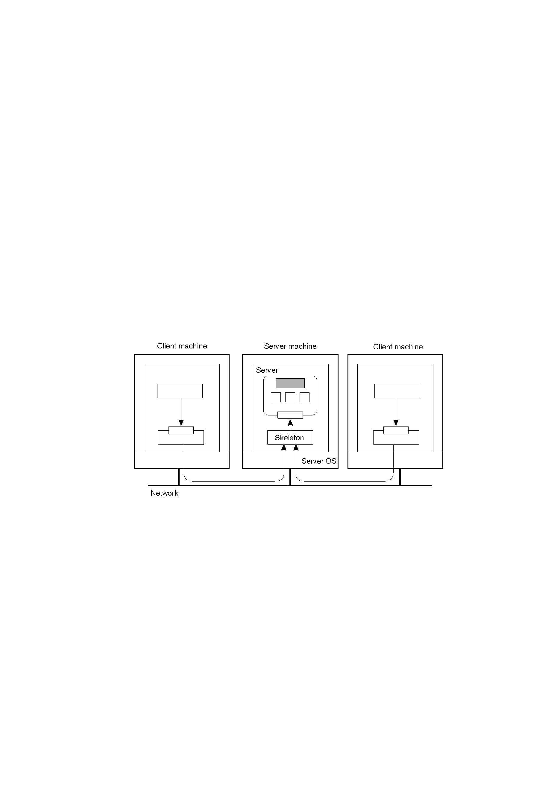
Concurrent Object Access: Problem
Figure 1-1: Concurrent Object Access
Organization of a distributed remote object shared by two different clients. But, how do we protect the object in the presence of multiple simultaneous accesses?

Slide 34
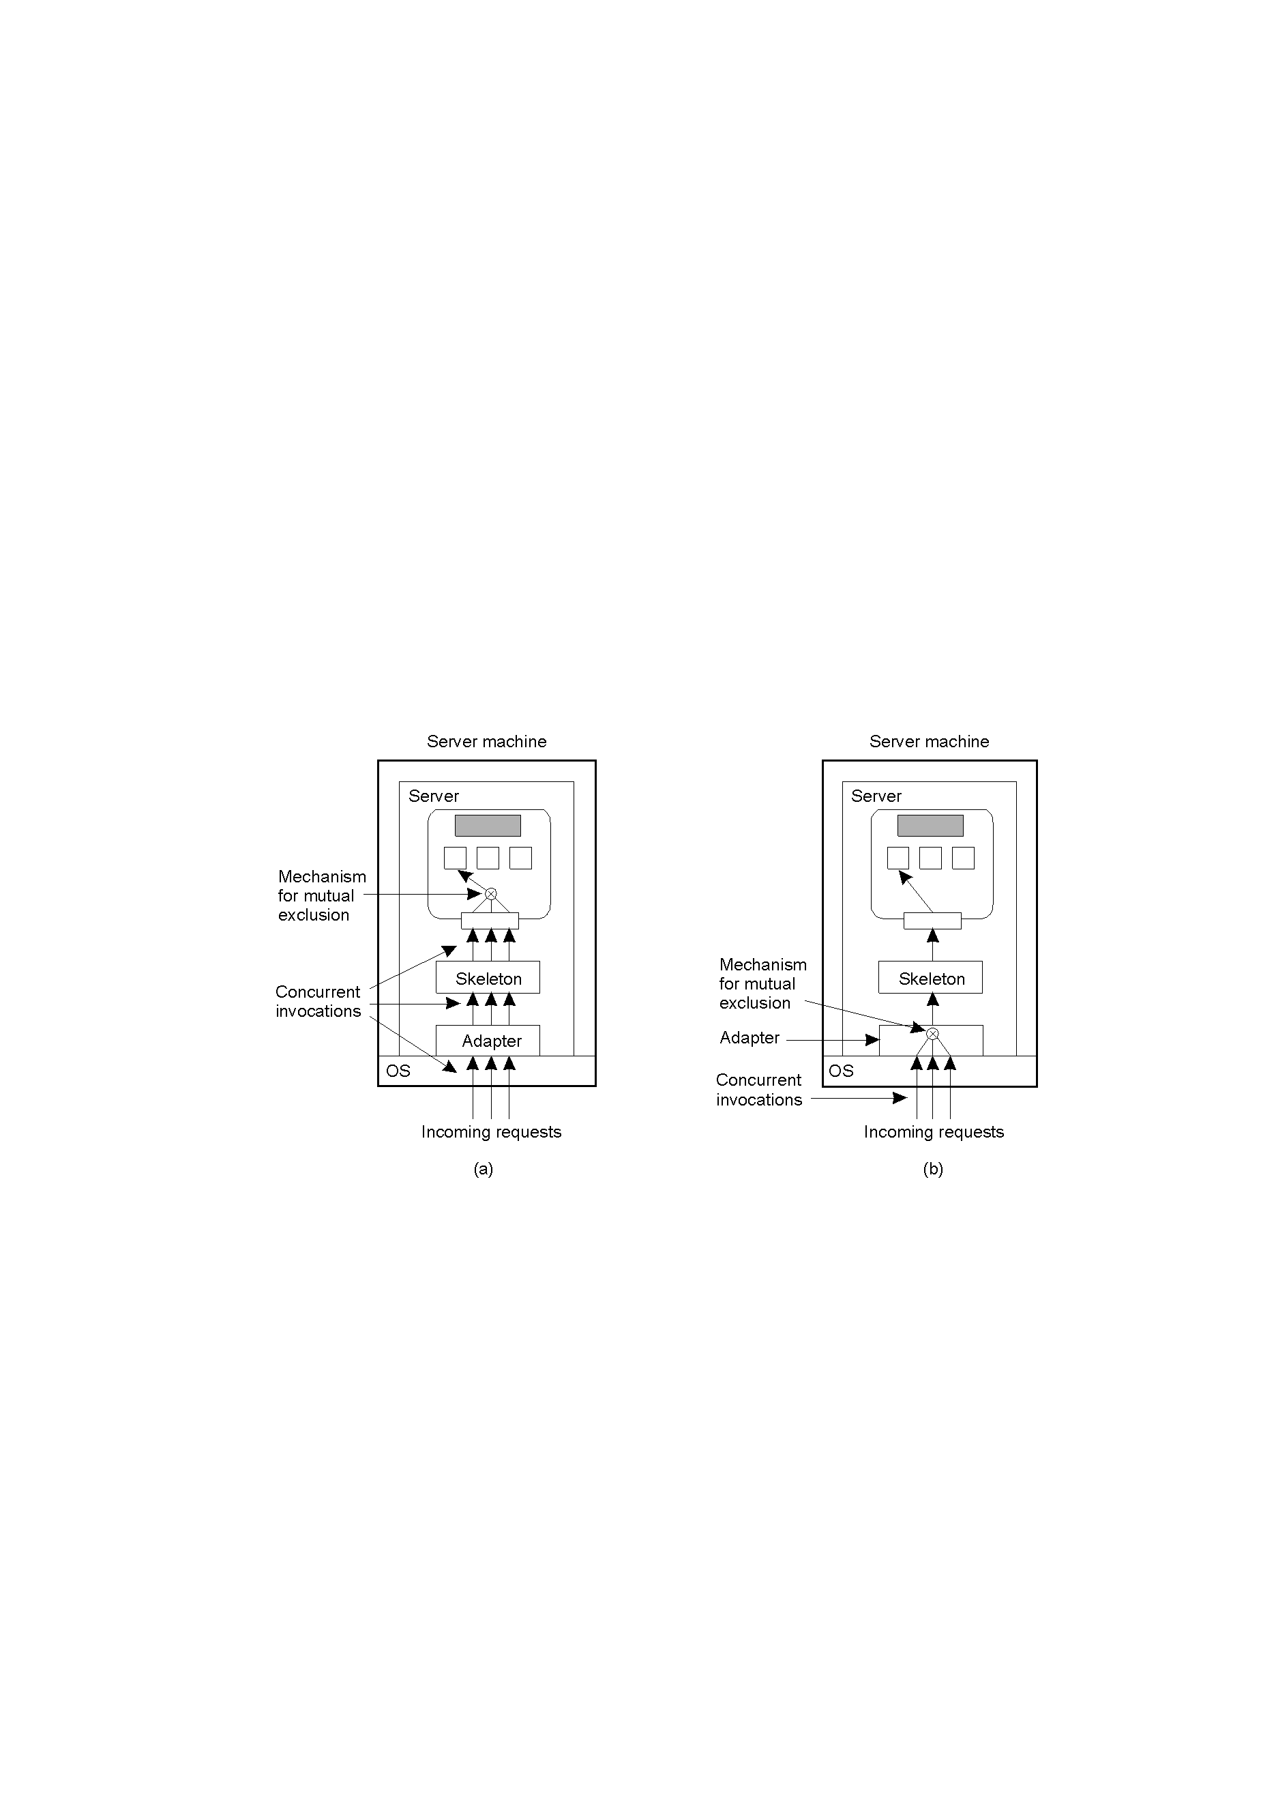
Concurrent Object Access: Solutions
Figure 1-2: Concurrent Object Access
A remote object capable of handling concurrent invocations on its own.
A remote object for which an object adapter is required to handle concurrent invocations (relies on middleware).

Slide 35
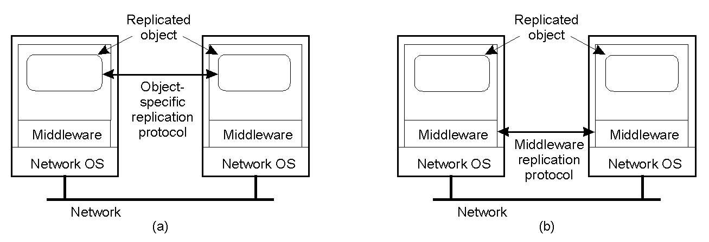
Object Replication: Solutions
Figure 1-3: Replication
A distributed system for replication-aware distributed objects – the object itself is “aware” that it is replicated. This is a very flexible set-up, but can be costly in that the DS developer has to concern themselves with replication/consistency.
A distributed system responsible for replica management – less flexible, but removes the burden from the DS developer. This is the most common approach.

Slide 36
Replication and Scalability
Replication is a widely-used scalability technique: think of web clients and web proxies.
When systems scale, the first problems to surface are those associated with performance as the systems get bigger (e.g. more users), they often get slower.
Replicating the data and moving it closer to where it is needed helps solve this scalability problem.

Slide 37
Replication and Scalability
The problem remains: how to efficiently synchronize all of the replicas created to solve the scalability issue.
Dilemma: adding replicas improves scalability, but incurs the (oftentimes considerable) overhead of keeping the replicas up-to-date!!!
As we shall see, the solution often results in a relaxation of any consistency constraints.

Slide 38
What is a Consistency Model?
Definition:
A “consistency model” is a CONTRACT between a DS data-store and its processes.
If the processes agree to the rules, the data-store will perform properly and as advertised.
We start with Strict Consistency, which is defined as:
Any read on a data item ‘x’ returns a value corresponding to the result of the most recent write on ‘x’ (regardless of where the write occurred).

Slide 39
Consistency Models…
Consistency models:
  Data-centric consistency models
  Client-centric consistency models
Relax the requirement that all updates be carried out atomically.
  Result – copies may not always be identical.
Solution: different definitions of consistency, known as consistency models.
As it turns out, we may be able to live with occasional inconsistencies.

Slide 40
Consistency Models…
Consistency models:
  Data-centric consistency models
  Client-centric consistency models

Slide 41
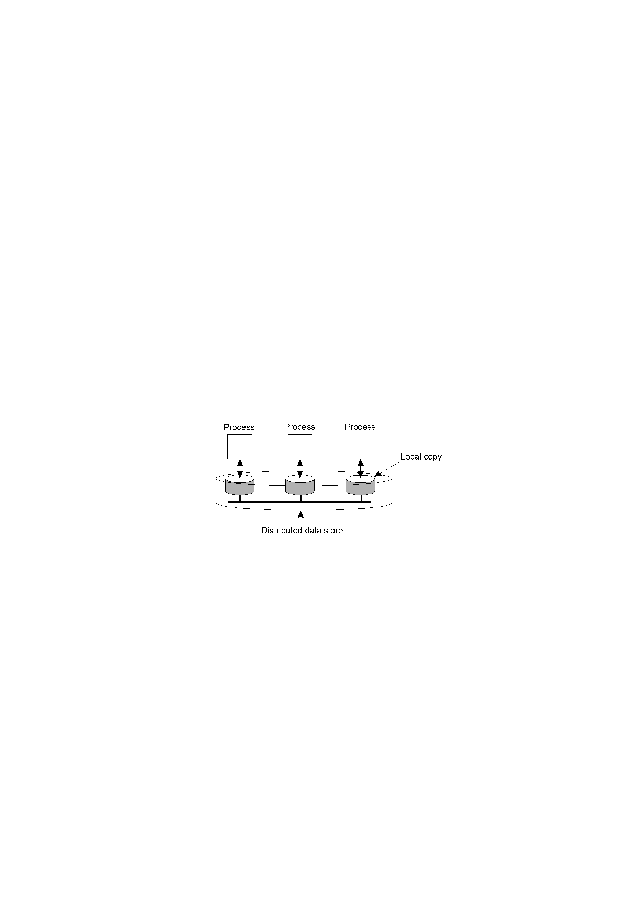
Data-Centric Consistency Models
A data-store can be read from or written to by any process in a distributed system.
A local copy of the data-store (replica) can support “fast reads”.
However, a write to a local replica needs to be propagated to ALL remote replicas.
Figure 1-4: Replication
Various consistency models help us understand the various mechanisms used to achieve and enable this.

Slide 42
Consistency Model Diagram Notation…
W_{i}(x)a – a write by process ‘i’ to item ‘x’ with a value of ‘a’. That is, ‘x’ is set to ‘a’.
(Note: The process is often shown as ‘P_{i}’).
R_{i}(x)b – a read by process ‘i’ from item ‘x’ producing the value ‘b’. That is, reading ‘x’ returns ‘b’.
Time moves from left to right in all diagrams.

Slide 43

Strict Consistency Diagrams…
Figure 1-5: Consistency
Behavior of two processes, operating on the same data item:
A strictly consistent data-store.
A data-store that is not strictly consistent.
With Strict Consistency, ALL writes are instantaneously visible to ALL processes and absolute global time order is maintained throughout the DS. This is the consistency model “Holy Grail” – not at all easy in the real world, but impossible within a DS.
Hence other, less strict (or “weaker”) models have been developed …

Slide 44
Sequential Consistency…
A weaker consistency model, which represents a relaxation of the rules.
It is also much easier (possible) to implement.
Definition of “Sequential Consistency”:
The result of any execution is the same as if the (read and write) operations by all processes on the data-store were executed in the same sequential order and the operations of each individual process appear in this sequence in the order specified by its program.

Slide 45

Sequential Consistency Diagrams…
In other words: all processes see the same interleaving set of operations, regardless of what that interleaving is.
Figure 1-6: Sequential Consistency
A sequentially consistent data-store – the “first” write occurred after the “second” on all replicas.
A data-store that is not sequentially consistent – it appears the writes have occurred in a non-sequential order, and this is NOT allowed.

Slide 46
Problem with Sequential Consistency…
With this consistency model, adjusting the protocol to favour reads over writes (or vice-versa) can have a devastating impact on performance.
For this reason, other weaker consistency models have been proposed and developed.
Again, a relaxation of the rules allows for these weaker models to make sense.

Slide 47
Linearizability and Sequential Consistency…
Process P1 | Process P2 | Process P3
x = 1; print ( y, z); | y = 1; print (x, z); | z = 1; print (x, y);
Figure 1-7: Linearizability & Sequential Consistency
Three concurrently executing processes.

Slide 48
Linearizability and Sequential Consistency…
Four valid execution sequences for the processes of the previous slide.
x = 1; print (y, z); y = 1; print (x, z); z = 1; print (x, y); Prints: 001011 Signature: 001011 (a) | x = 1; y = 1; print (x,z); print(y, z); z = 1; print (x, y); Prints: 101011 Signature: 101011 (b) | y = 1; z = 1; print (x, y); print (x, z); x = 1; print (y, z); Prints: 010111 Signature: 010111 (c) | y = 1; x = 1; z = 1; print (x, z); print (y, z); print (x, y); Prints: 111111 Signature: 111111 (d)
But for instance, 001001 is not allowed.
Figure 1-8: Linearizability & Sequential Consistency

Slide 49
Causal Consistency…
This model distinguishes between events that are “causally related” and those that are not.
If event B is caused or influenced by an earlier event A, then causal consistency requires that every other process see’s event A, then event B.
Operations that are not causally related are said to be concurrent.

Slide 50

A Causal Consistency Example…
incorrect
correct
Figure 1-9: Causal Consistency Example
Violation of causal-consistency – P2’s write is related to P1’s write due to the read on ‘x’ giving ‘a’ (all processes must see them in the same order).
A causally-consistent data-store: the read has been removed, so the two writes are now concurrent. The reads by P3 and P4 are now OK.

Slide 51
FIFO Consistency…
Defined as follows:
Writes done by a single process are seen by ALL other processes in the order in which they were issued, but writes from different processes may be seen in a different order by different processes.
This is also called “PRAM Consistency” – Pipelined RAM.
The attractive characteristic of FIFO is that it is easy to implement. There are no guarantees about the order in which different processes see writes – except that two or more writes from a single process must be seen in order.

Slide 52

FIFO Consistency Example…
Figure 1-10: FIFO Consistency Example
A valid sequence of FIFO consistency events.
Note that none of the consistency models studied so far would allow this sequence of events.

Slide 53
Introducing Weak Consistency
Not all applications need to see all writes, let alone seeing them in the same order.
This leads to “Weak Consistency” (which is primarily designed to work with distributed critical regions).
This model introduces the notion of a “synchronization variable”, which is used update all copies of the data-store.

Slide 54
Weak Consistency Properties…
The three properties of Weak Consistency:
  Accesses to synchronization variables associated with a data-store are sequentially consistent.
  No operation on a synchronization variable is allowed to be performed until all previous writes have been completed everywhere.
  No read or write operation on data items can be performed until all previous operations to synchronization variables have been performed.

Slide 55
Weak Consistency: What It Means…
So …
By doing a sync., a process can force the just written value out to all the other replicas.
Also, by doing a sync., a process can be sure it’s getting the most recently written value before it reads.
In essence, the weak consistency models enforce consistency on a group of operations, as opposed to individual reads and writes (as is the case with strict, sequential, causal and FIFO consistency).

Slide 56

Weak Consistency Examples…
before sync., any results are acceptable
Wrong!!
Figure 1-11: Weak Consistency Example
A valid sequence of events for weak consistency. This is because P2 and P3 have yet to synchronize, so there’s no guarantees about the value in ‘x’.
An invalid sequence for weak consistency. P2 has synchronized, so it cannot read ‘a’ from ‘x’ – it should be getting ‘b’.

Slide 57
Introducing Release Consistency…
Question: how does a weakly consistent data-store ‘know’ that the sync is the result of a read or a write?
Answer: It doesn’t!
It is possible to implement efficiencies if the data-store is able to determine whether the sync is a read or write.
Two sync variables can be used, “acquire” and “release”, and their use leads to the “Release Consistency” model.

Slide 58
Release Consistency…
Defined as follows:
When a process does an “acquire”, the data-store will ensure that all the local copies of the protected data are brought up to date to be consistent with the remote ones if need be.
When a “release” is done, protected data that have been changed are propagated out to the local copies of the data-store.

Slide 59

Release Consistency Example…
Figure 1-12: Release Consistency Example
A valid event sequence for release consistency.
Process P3 has not performed an acquire, so there are no guarantees that the read of ‘x’ is consistent. The data-store is simply not obligated to provide the correct answer.
P2 does perform an acquire, so its read of ‘x’ is consistent.

Slide 60
Release Consistency Rules…
A distributed data-store is “Release Consistent” if it obeys the following rules:
  Before a read or write operation on shared data is performed, all previous “acquires”, done by the process must have completed successfully.
  Before a “release” is allowed to be performed, all previous reads and writes by the process must have completed.
  Accesses to synchronization variables are FIFO consistent (sequential consistency is not required).

Slide 61
Introducing Entry Consistency…
A different twist on things is “Entry Consistency”. “Acquire” and “release” are still used, and the data-store meets the following conditions:
    An acquire access of a synchronization variable is not allowed to perform with respect to a process until all updates to the guarded shared data have been performed with respect to that process.
    Before an exclusive mode access to a synchronization variable by a process is allowed to perform with respect to that process, no other process may hold the synchronization variable, not even in non-exclusive mode.
    After an exclusive mode access to a synchronization variable has been performed, any other process's next non-exclusive mode access to that synchronization variable may not be performed until it has performed with respect to that variable's owner.

Slide 62

Entry Consistency: What It Means…
So at an acquire, all remote changes to guarded data must be brought up to date.
Before a write to a data item, a process must ensure that no other process is trying to write at the same time.
Figure 1-13: Entry Consistency Example
Locks associate with individual data items, as opposed to the entire data-store. Note: P2’s read on ‘y’ returns NIL as no locks have been requested.

Slide 63
Summary of Consistency Models…
Consistency | Description
Strict | Absolute time ordering of all shared accesses matters.
Linearizability | All processes must see all shared accesses in the same order. Accesses are furthermore ordered according to a (non-unique) global timestamp.
Sequential | All processes see all shared accesses in the same order. Accesses are not ordered in time.
Causal | All processes see causally-related shared accesses in the same order.
FIFO | All processes see writes from each other in the order they were used. Writes from different processes may not always be seen in that order.
 | (a)
Consistency | Description
Weak | Shared data can be counted on to be consistent only after a synchronization is done.
Release | Shared data are made consistent when a critical region is exited.
Entry | Shared data pertaining to a critical region are made consistent when a critical region is entered.
 | (b)
Consistency models that do not use synchronization operations.
Models that do use synchronization operations. (These require additional programming constructs, and allow programmers to treat the data-store as if it is sequentially consistent, when in fact it is not. They “should” also offer the best performance).
Table 1-1: Summary of (Data Centric) Consistency Models

Slide 64
Overview
Reasons for Replication
Data-centric Consistency Models:
  Strict Consistency
  Sequential Consistency
  Causal Consistency No Sync Variable
  FIFO Consistency
  Weak Consistency
  Release Consistency Sync Variable
  Entry Consistency

Slide 65
Data-Centric Consistency Model Diagram Notation…
W_{i}(x)a – a write by process ‘i’ to item ‘x’ with a value of ‘a’. That is, ‘x’ is set to ‘a’.
(Note: The process is often shown as ‘P_{i}’).
R_{i}(x)b – a read by process ‘i’ from item ‘x’ producing the value ‘b’. That is, reading ‘x’ returns ‘b’.
Time moves from left to right in all diagrams.

Slide 66
Consistency Models…
Consistency models:
  Data-centric consistency models
  Client-centric consistency models

Slide 67
Client-Centric Consistency Models
The previously studied consistency models concern themselves with maintaining a consistent (globally accessible) data-store in the presence of concurrent read/write operations.
Another class of distributed data-store is that which is characterized by the lack of simultaneous updates. Here, the emphasis is more on maintaining a consistent view of things for the individual client process that is currently operating on the data-store.

Slide 68
Client-centric Consistency Models…
We can avoid system-wide consistency by concentrating on what speciﬁc clients want, instead of what should be maintained by servers.
In many cases the system:
  Has much more reads than updates
  Only one process is responsible of updates.

Slide 69
More Client-Centric Consistency…
How fast should updates (writes) be made available to read-only processes?
Think of most database systems: mainly read.
Think of the DNS: write-write conflicts do not occur.
Think of WWW: as with DNS, except that heavy use of client-side caching is present: even the return of stale pages is acceptable to most users.
These systems all exhibit a high degree of acceptable inconsistency … with the replicas gradually becoming consistent over a period of time.

Slide 70
An Example: The Bayou System…
Definition: a platform of replicated, highly- available, variable-consistency, mobile databases on which to build collaborative applications.
Implements 4 models of Client-Centric Consistency:
Monotonic-Read Consistency
Monotonic-Write Consistency
Read-Your-Writes Consistency
Writes-Follow-Reads Consistency

Slide 71
Client-Centric Consistency Model Diagram Notation…
WS(x_{i}[t]) is the set of write operations (at L_{i}) that lead to version x_{i} of x (at time t).
WS(x_{i} [t1];x_{j}[t2]) indicates that it is known that WS(x_{i}[t1]) is part of WS(x_{j}[t2]).
Time moves from left to right in all diagrams.
Note: Parameter t is omitted from ﬁgures.

Slide 72
Eventual Consistency
In some systems, it is sufficient that after some time (eventually) all updates propagate to all replicas.
Example:
Consider a distributed database (shown in the following slide) to which you have access through your notebook.
At location A you access the database doing reads and updates.
At location B you continue your work, but unless you access the same server as the one at location A, you may detect inconsistencies.

Slide 73
Toward Eventual Consistency…
The only requirement is that all replicas will eventually be the same.
All updates must be guaranteed to propagate to all replicas … eventually!
This works well if every client always updates the same replica.
Things are a little difficult if the clients are mobile.

Slide 74
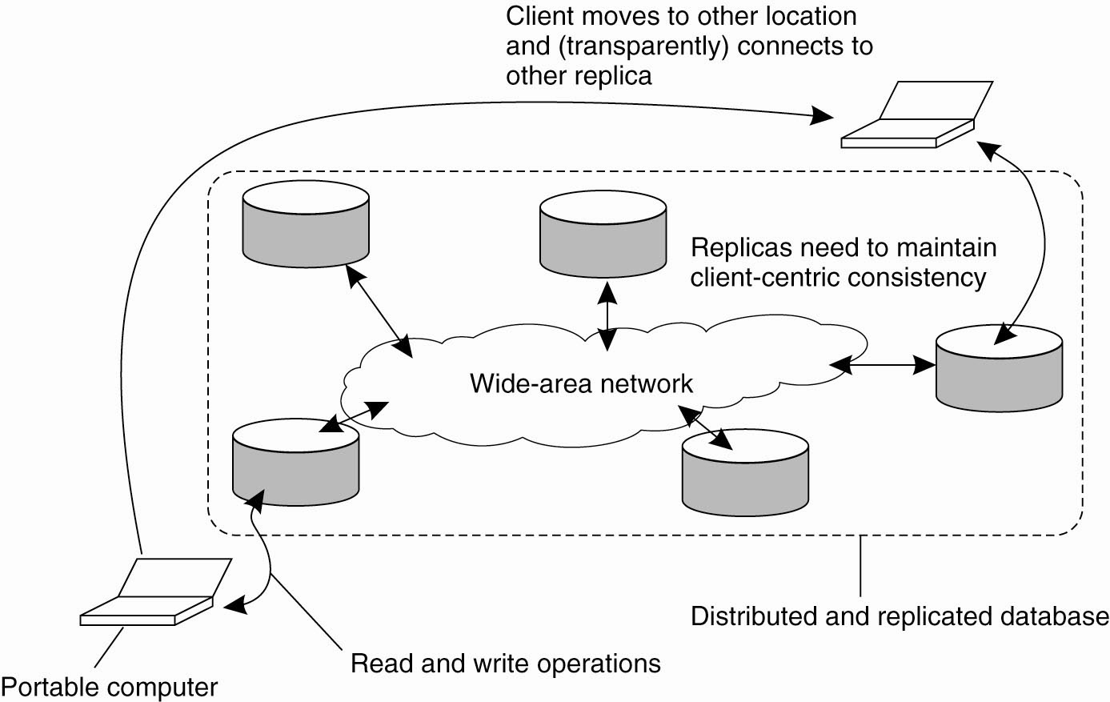
Eventual Consistency…
your updates at A may not have yet been propagated to B.
you may be reading newer entries than the ones available at A.
your updates at B may eventually conﬂict with those at A.

Slide 75
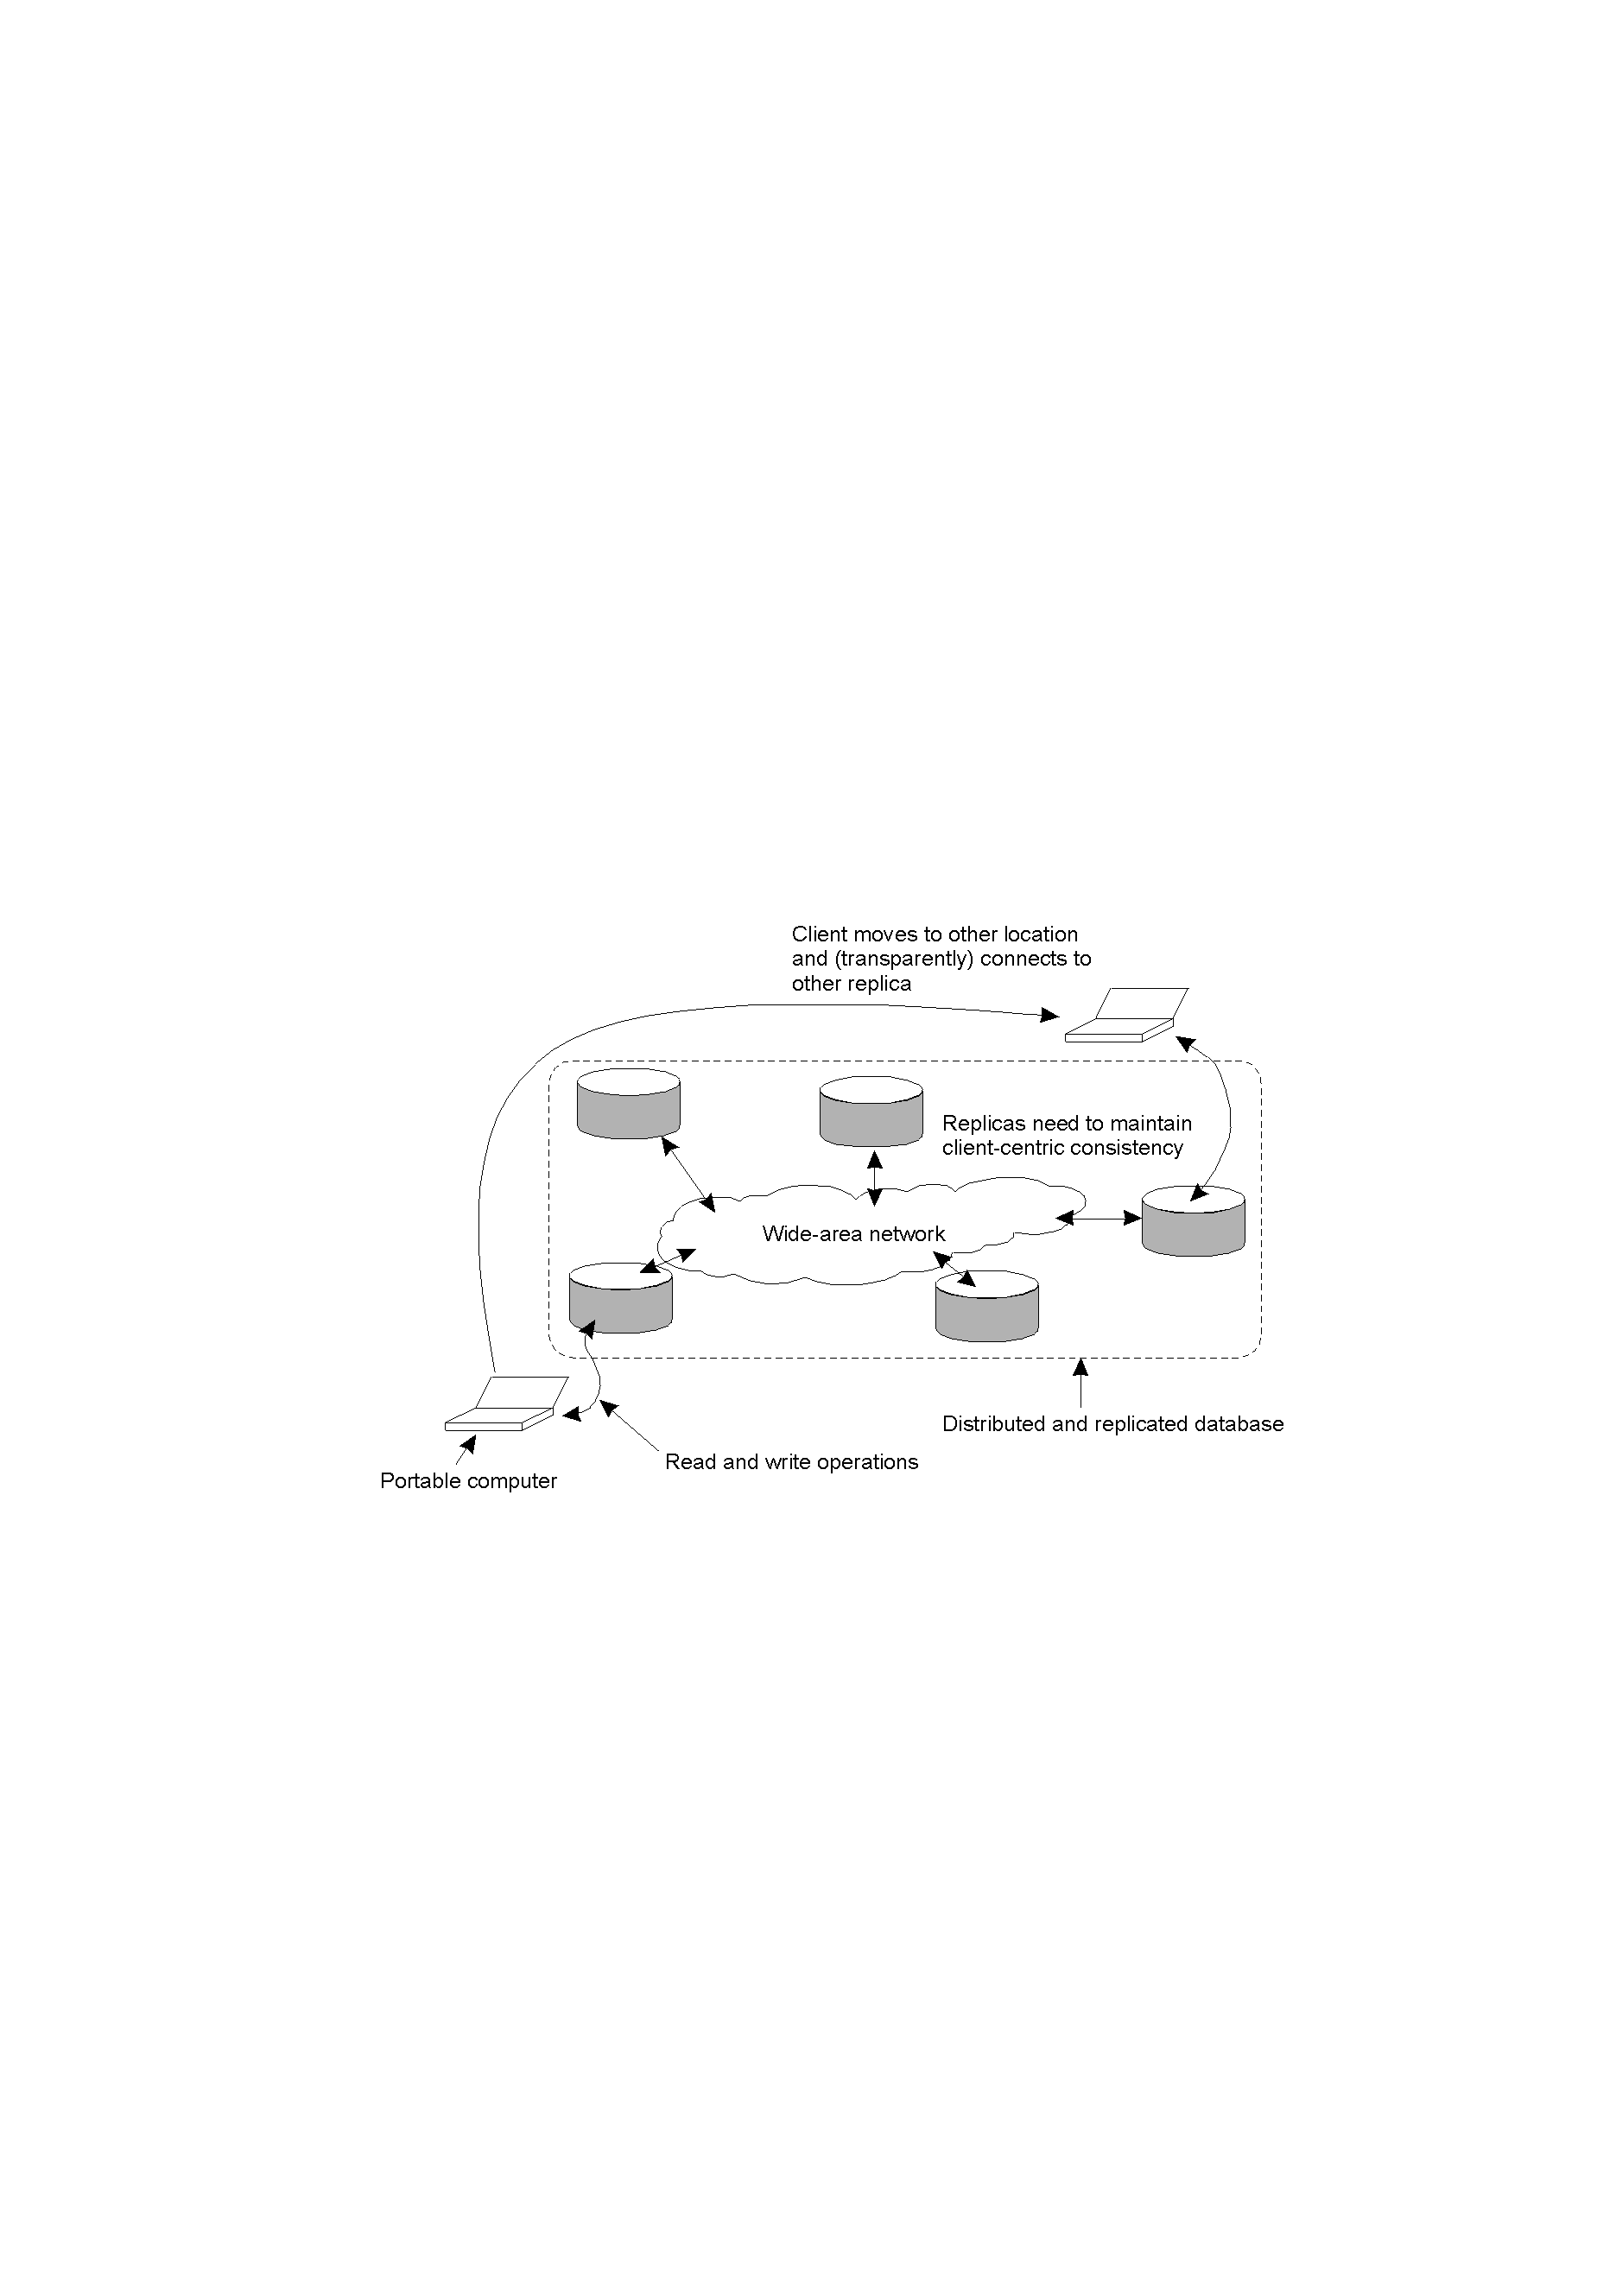
Eventual Consistency: Mobile Problems…
Figure 1-13: Mobile Problems
The principle of a mobile user accessing different replicas of a distributed database.
When the system can guarantee that a single client ‘sees’/accesses the data-store in a consistent way, we say that “client-centric consistency” holds.

Slide 76
Eventual Consistency…
The only thing you really want is that the entries you updated and/or read at A, are in B the way you left them in A. In that case, the database will appear to be consistent to you.
Notation:
  WS(x_{i}[t]) is the set of write operations (at L_{i}) that lead to version x_{i} of x (at time t)
  WS(x_{i} [t1];x_{j}[t2]) indicates that it is known that WS(x_{i}[t1]) is part of WS(x_{j}[t2]).
Note: Parameter t is omitted from ﬁgures.

Slide 77
Monotonic Reads
A data store is said to provide monotonic-read consistency if the following condition holds:
If a process reads the value of a data item x, any successive read operation on x by that process will;
  always return that same value
  or a more recent value.
Example: Checking the email inbox.

Slide 78
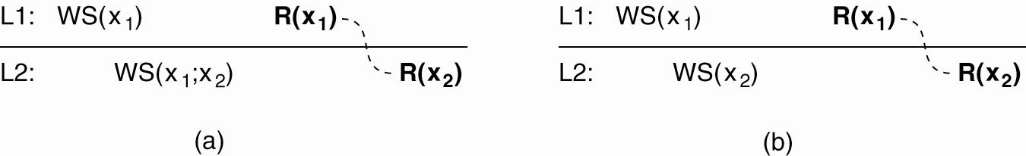
Monotonic Reads…
The read operations performed by a single process P at two different local copies of the same data store.
(a) A monotonic-read consistent data store.

Slide 79
Monotonic Reads…
(b) A data store that does not provide monotonic reads.
The problem is that only the set of operations WS(x₂) is performed in L2; the set of operations WS(x₁) is not performed (i.e. not part of WS(x₂) )in L2.

Slide 80
Monotonic Writes
In a monotonic-write consistent store, the following
condition holds:
A write operation by a process on a data item x…
  is completed before any successive write operation on x
  by the same process.
Example: Maintaining versions of replicated ﬁles.

Slide 81
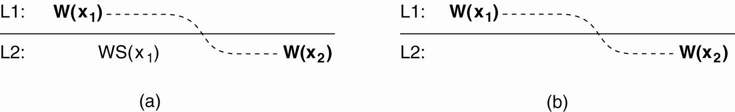
Monotonic Writes…
The write operations performed by a single process P at two different local copies of the same data store.
(a) A monotonic-write consistent data store.

Slide 82
Monotonic Writes…
(b) A data store that does not provide monotonic-write consistency.
The problem is that the set of operations WS(x₁) is not performed (i.e. not part of WS(x₂)) in L2.

Slide 83
Read Your Writes
A data store is said to provide read-your-writes consistency if the following condition holds:
The effect of a write operation by a process on data item x…
  will always be seen by a successive read operation on x
  by the same process.
Example: Updating you own web pages.

Slide 84
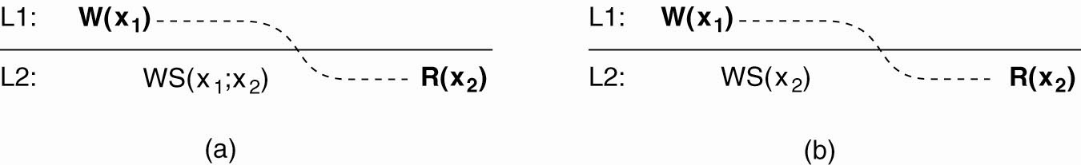
Read Your Writes…
The write and read operations performed by a single process P at two different local copies of the same data store.
(a) A data store that provides read-your-writes consistency.

Slide 85
Read Your Writes…
(b) A data store that does not provides read-your-writes consistency.
The problem is that the set of operations WS(x₁;x₂) is not performed (i.e. not part of WS(x₂)) in L2.

Slide 86
Writes Follow Reads
A data store is said to provide writes-follow-reads consistency if the following holds:
A write operation by a process on a data item x following a previous read operation on x by the same process …
  is guaranteed to take place on the same or a more recent value of x that was read.
Example: Store reactions to posted articles only if you have the original posting.

Slide 87

Writes Follow Reads…
(a) A writes-follow-reads consistent data store.

Slide 88
Writes Follow Reads…
(b) A data store that does not provide writes-follow-reads consistency.
The problem is that the set of operations WS(x₁;x₂) is not performed (i.e. not part of WS(x₂)) in L2.

Slide 89
Naming Summary
Types of names:
  Addresses
  Identifiers
  Human friendly
Representation of names:
  Human friendly format
  Machine readable – generally random bit strings.

Slide 90
Consistency and Replication Summary
Reasons for replication:
  improved performance,
  improved reliability.
Replication can lead to inconsistencies …
How best can we propagate updates so that these inconsistencies are not noticed?
With “best” meaning “without crippling performance”.
The proposed solutions revolve around the relaxation of any existing consistency constraints.

Slide 91
Consistency and Replication Summary…
Various consistency models have been proposed:
  Strict, Sequential, Causal, FIFO concern themselves with individual reads/writes to data items.
  Weaker models introduce the notion of synchronisation variables: Release, Entry concern themselves with a group of reads/writes.
  These models are known as “Data-Centric”.
“Client Centric” models also exist:
  Concerned with maintaining consistency for a single clients’ access to the distributed data-store.
  The Eventual Consistency model is an example.

Slide 92
Consistency and Replication Summary…
To distribute (or “propagate”) updates, we draw a distinction between WHAT is propagated, WHERE it is propagated and by WHOM.
We looked at various Distribution Protocols and Consistency Protocols designed to facilitate the propagation of updates.
The most widely implemented schemes are those that support Sequential Consistency or Weak Consistency with Synchronisation Variables.

Slide 93
Recommended Reading…
http://www.zib.eu/schuett/papers/iccs2003.pdf
http://www.tkn.tu-berlin.de/fileadmin/fg112/Papers/consistency_tr1.pdf
http://airccse.org/journal/ijdms/papers/1110ijdms08.pdf

Slide 94
Next Week…
Mid Semester Exam

